Slide 1

STA 2002
Lecture 7
Comparing two hypotheses
The Neyman-Pearson paradigm

Slide 2
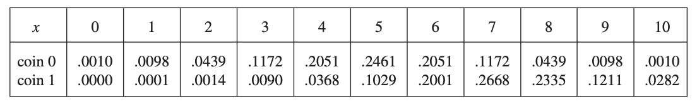
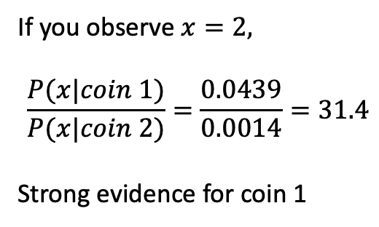
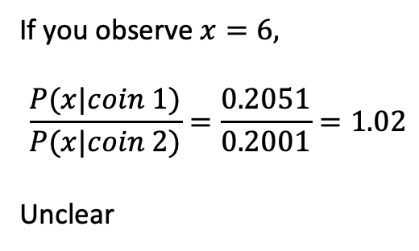
Comparing two hypotheses
I have two coins, coin 0 has probability of heads equal to 0.5 and coin 1 has probability of heads equal to 0.7.
I choose one of the coins, toss it 10 times, and tell you the number of heads.
I ask you: which coin did I use?
P(x|coin)
If you observe $x=2,$
$$\frac{P(x|coin 1)}{P(x|coin 2)}=\frac{0.0439}{0.0014}=31.4$$
Strong evidence for coin 1
If you observe $x=6,$
$$\frac{P(x|coin 1)}{P(x|coin 2)}=\frac{0.2051}{0.2001}=1.02$$
Unclear
the “likelihood ratio”

Slide 3
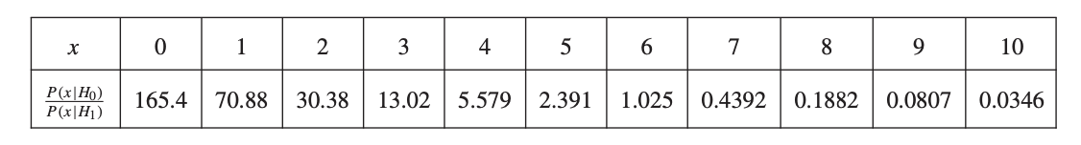
Comparing two hypotheses
H₀: coin 0 was used
H₁: coin 1 was used
What may a reasonable decision rule for you to decide which hypothesis to pick?
Choose H₀
Choose H₁
Decision Rule: Accept H₀ if $\frac{P(x|H_{0})}{P(x|H_{1})}>1$. Reject H₀ and hence accept H₁ otherwise

Slide 4
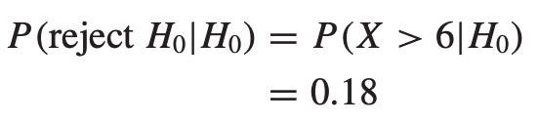
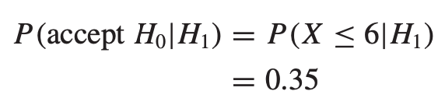
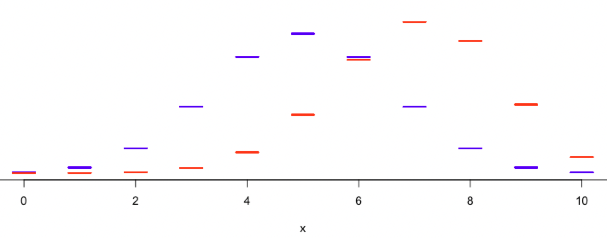
Comparing two hypotheses
What is our risk by making the decision based on likelihood ratio?
 | Accept H₀ (x≤6) | Reject H₀ (x>6)
H₀ is true | 0.82 | 0.18
H₁ is true | 0.35 | 0.65
Decision boundary
Accept H₀
Reject H₀
P(x|coin)

Slide 5
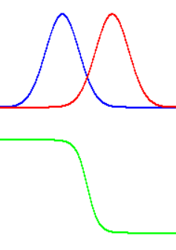
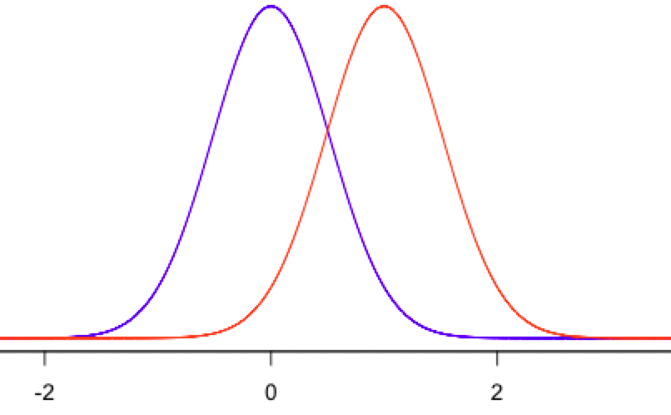

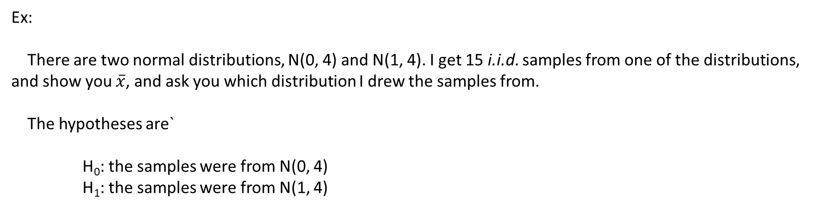


Comparing two hypotheses
Ex:
There are two normal distributions, N(0, 4) and N(1, 4). I get 15 i.i.d. samples from one of the distributions, and show you $\overline{x}$, and ask you which distribution I drew the samples from.
The hypotheses are`
H₀: the samples were from N(0, 4)
H₁: the samples were from N(1, 4)
Decision boundary
Accept H₀
Reject H₀
Distribution of $\overline{x}$ if H₀ is true
Distribution of $\overline{x}$ if H₁ is true
$$\frac{f\left(\overline{x}|H_{0}\right)}{f\left(\overline{x}|H_{0}\right)+f\left(\overline{x}|H_{1}\right)}$$
𝛽 =P(Accept H₀ | H₁ is true)
𝛼=P(Reject H₀ | H₀ is true): level of significance

Slide 6
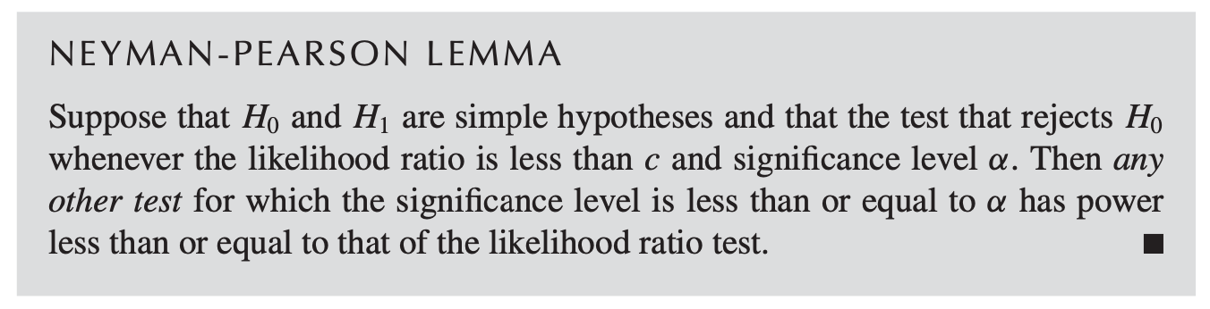
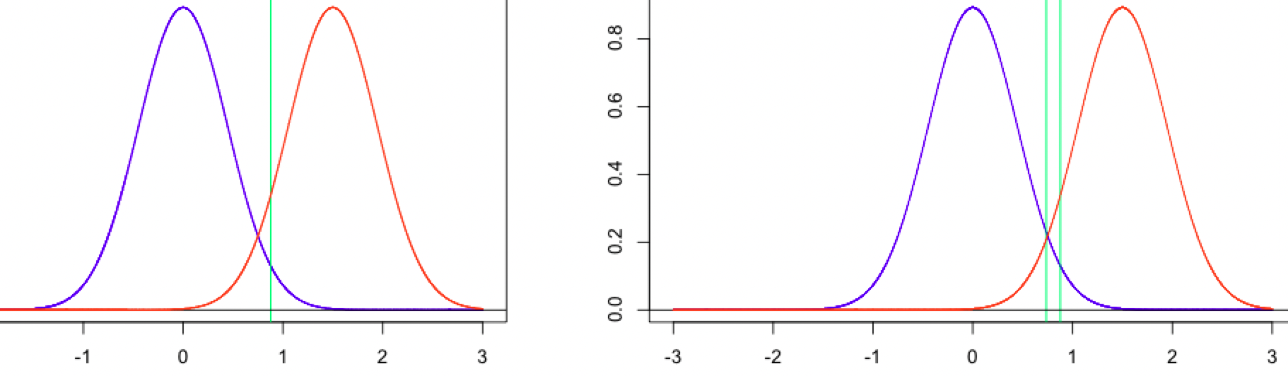
The Neyman-Pearson Lemma
Power=P(Reject H₀ | H₁ is true)
Given α, if the critical region is selected based on likelihood ratio, the test achieves best possible power.
Rejection region
(critical region)
Rejection region
(critical region)
Acceptance region
Acceptance region
Acceptance region
Best power
Low power

Slide 7
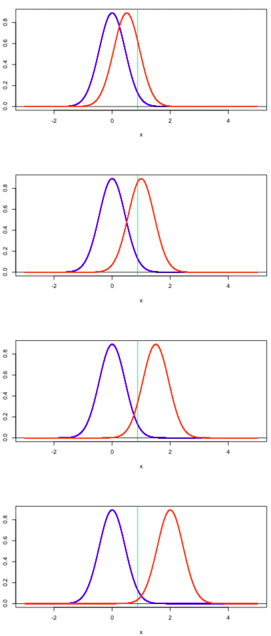

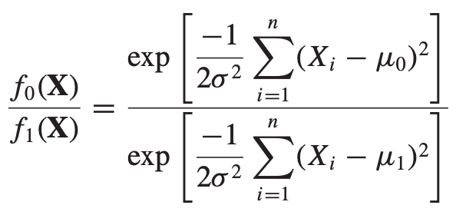

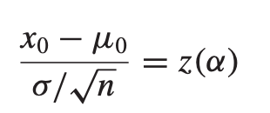
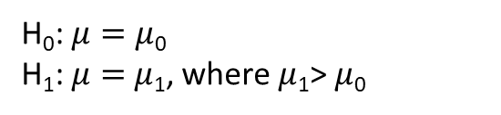
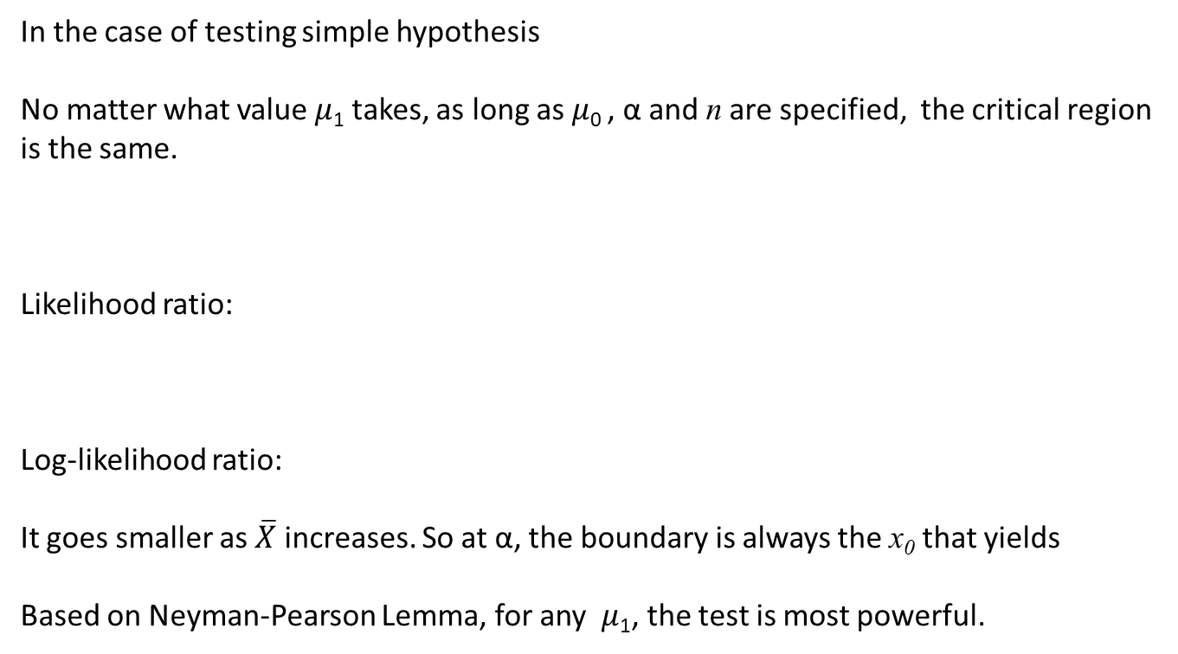
The Neyman-Pearson Lemma
x₀
H₀: $μ=μ$₀
H₁: $μ=$ $μ$₁, where $μ$₁> $μ$₀
In the case of testing simple hypothesis
No matter what value $μ$₁ takes, as long as $μ$₀ , α and n are specified, the critical region is the same.
Likelihood ratio:
Log-likelihood ratio:
It goes smaller as $\overline{X}$ increases. So at α, the boundary is always the x₀ that yields
Based on Neyman-Pearson Lemma, for any $μ$₁, the test is most powerful.
x₀
x₀
x₀
The test is uniformly most powerful - it is most powerful for every simple alternative in H₁.

Slide 8
The Neyman-Pearson paradigm
Ex:
You got a single coin. You want to know if it is a fair coin. What are you testing against?
H₀: p=0.5
H₁: p=1.0
H₀: p=0.5
H₁: p=0.6
H₀: p=0.5
H₁: p=0.85
H₀: p=0.5
H₁: p=0.211
H₀: p=0.5
H₁: p=0.43
H₀: p=0.5
H₁: p=0.688889
H₀: p=0.5
H₁: p=0.31415926
No distribution function under the alternative hypothesis
H₀: p=0.5
H₁: p≠0.5
A composite alternative hypothesis

Slide 9
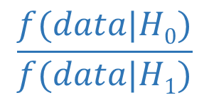
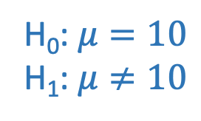
The Neyman-Pearson paradigm
Ex:
American cats weigh 10 pounds on average. You want to know if Chinese cats have the same mean weight. You gathered 20 cats and measured their weights.
(Let’s ignore the variance for now)
No distribution function under the alternative hypothesis
H₀: $μ=10$
H₁: $μ≠10$
A composite alternative hypothesis
$$\frac{f(data|H0)}{f(data|H1)}$$
No likelihood
ratio

Slide 10
The Neyman-Pearson paradigm
There is no distribution function from a composite hypothesis.
Without a simple H₁ hypothesis, we cannot calculate 𝛽.
But we can still specify 𝛼, because H₀ specifies a simple hypothesis.
However, we can still find how likely the data is generated from the H₀.
We need to be very careful when rejecting H₀ – give it the “benefit of doubt”:
Only reject H₀ when there is strong evidence against it – use a small 𝛼 level.

Slide 11
The Neyman-Pearson paradigm
An asymmetry: one hypothesis is singled out as the null hypothesis and the other as the alternative hypothesis
the null hypothsis is usually denoted by H₀ and the alternative by H₁ or H_{A}
Test statistic: the statistic computed from a sample, based on which the decision is made.
e.g. proportion of heads, average, ......
Null distribution: the probability distribution of the test statistic when the null hypothesis is true
Type I error: rejecting H₀ when it is true.
Significance level (α): the probability of a type I error.
Type II error (β): accepting the null hypothesis when it is false.
Power of the test (1 − β): the probability that the null hypothesis is rejected when it is false.
Rejection region (critical region): the set of values of the test statistic that leads to rejection of the null hypothesis
Acceptance region: the set of values that leads to acceptance of the null hypothesis

Slide 12
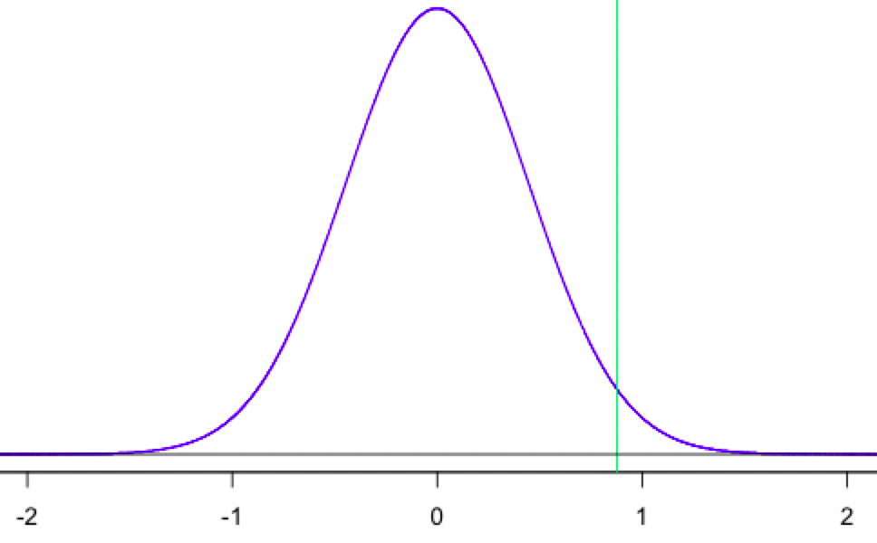
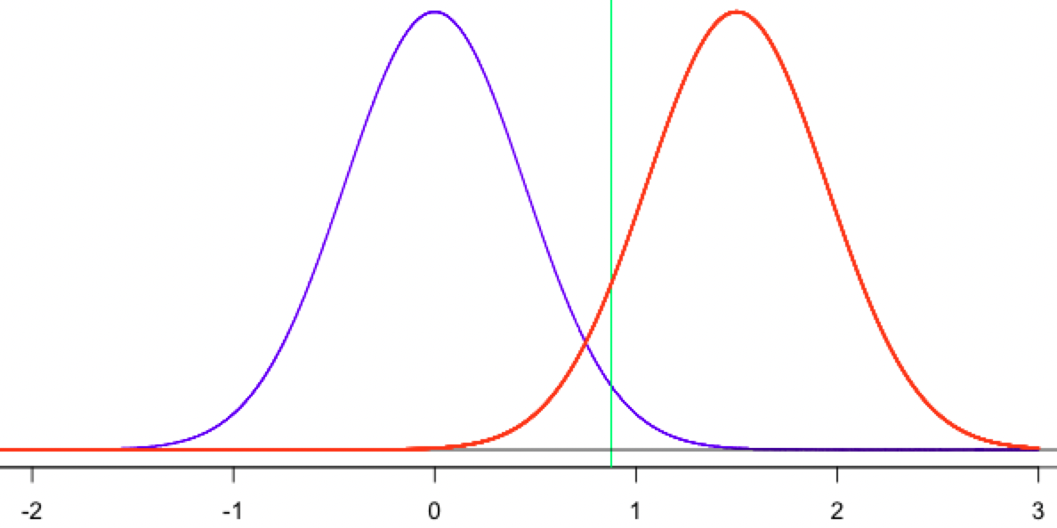
The Neyman-Pearson paradigm
Acceptance region
Rejection region (critical region)
Null distribution
Rejection region (critical region)
Acceptance region
α
Null distribution
1 − β
β
α

Slide 13
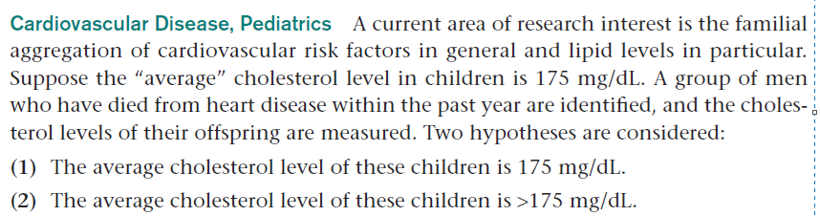
The type I error is deciding that offspring of men who died from heart disease have an average cholesterol level higher than 175 mg/dL when in fact their average cholesterol level is 175 mg/dL.
The type II error is deciding that the offspring have normal cholesterol levels when in fact their cholesterol levels are above average.

Slide 14

Think of it as a court trial
H₀: The defendant is innocent (The protected hypothesis)
We need strong evidence to convict (reject H₀)
How likely is it to observe the evidence (data) if the defendant is innocent?
It is very unlikely to observe the evidence if the defendant is innocent → Convict! (Small p; Reject H₀)
It is plausible to observe the evidence if the defendant is innocent → Don’t convict! (p not small enough; cannot reject H₀)

Slide 15


Think of it as a court trial
When an H₀ is not rejected –
Doesn’t mean it is true
It only means we don’t have sufficient evidence against it
Strength of evidence is subjective
Truth is (almost) never known

Slide 16
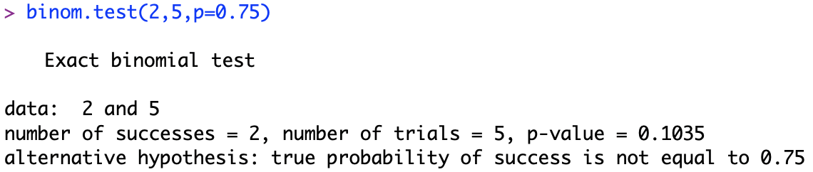
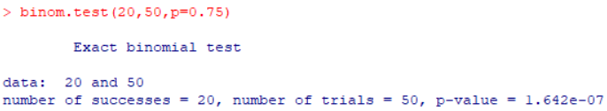
Think of it as a court trial
The unknown truth
Data
Testing results
Assumptions about true model

Slide 17


Think of it as a court trial
Type 1 error – mistakenly convict someone who is truly innocent (Reject H₀ when it is actually true) 𝛼
Type 2 error – let a true criminal walk free (Accept H₀ when it is actually false) 𝛽
A trade off:
If we require weaker evidence to convict, we make more type 1 error, and less type 2 error
We would rather let some criminal walk free, than mistakenly convict someone and ruin the innocent person’s life.
$$✓$$
疑罪从无
$$×$$
 | Accept H₀ | Reject H₀
H₀ is true |  | 𝛼
H₁ is true | 𝛽
宁枉勿纵

Slide 18
The p-value
But how to summarize the evidence against the null hypothesis? Falling into the critical region is not enough.
Acceptance region
Rejection region (critical region)
Null distribution
α
For a given evidence,
p-value: the smallest significance level at which the null hypothesis would be rejected
p-value is the probability of a result as or more extreme than that actually observed if the null hypothesis were true
p-value is NOT the probability that the null hypothesis is true

Slide 19
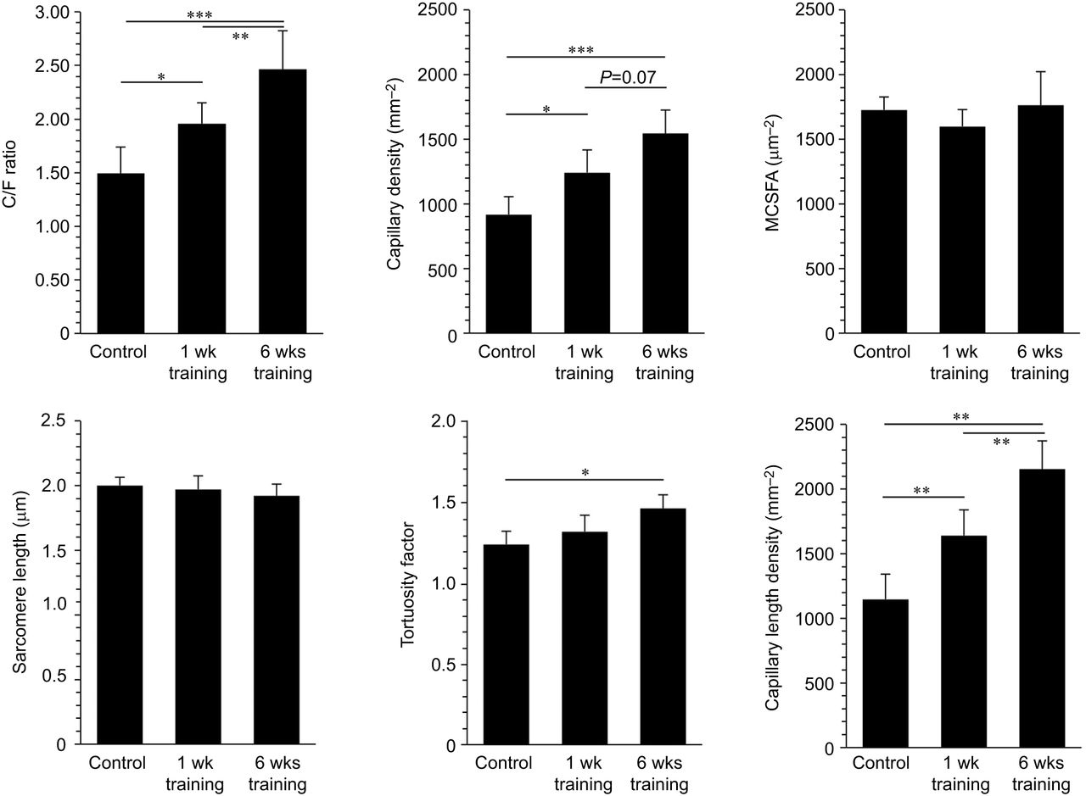
The p-value
Evidence presented, judgement left to reader:
*P<0.05,
**P<0.01,
***P<0.001
https://jeb.biologists.org/content/221/4/jeb171819

Slide 20
The non-statistical things
Which hypothesis is the null and which is the alternative is not a mathematical one, and depends on scientific context, custom, and convenience.
The choice of α is essentially arbitrary, but is heavily influenced by custom. Small values, such as 0.01 and 0.05, are commonly used.
Assign the hypothesis that you would like to show to be true as the alternative: data can only support the alternative hypothesis but NOT the null.
In scientific investigations, the null hypothesis is often an existing explanation that must be discredited based on (data) evidence, in order to demonstrate the presence of some physical phenomenon or effect given in the alternative hypothesis.
Rejecting the null hypothesis often leads to action.
The consequences of incorrectly rejecting one hypothesis may be graver than those of incorrectly rejecting the other.

Slide 21
Examples
A cigarette manufacturer advertises that its new low tar cigarette “contains on the average no more than 4 milligrams of tar”. A consumer agency would like to test this claim. Formulate the null and the alternative hypotheses.
H₀ : The cigarette contains no more than 4 milligrams of tar on average
H₁ : The cigarette contains more than 4 milligrams of tar on average

Slide 22
Examples
The production line for Glow toothpaste is designed to fill tubes of toothpaste with a mean weight of 6 ounces. Periodically, a sample of 30 tubes will be selected in order to check the filling process. Quality assurance procedures call for the continuation of the filling process if the sample results are consistent with the assumption that the mean filling weight for the population of toothpaste tubes is 6 ounces; otherwise the filling process will be stopped and adjusted.
H₀ : The mean filling weight is 6 ounces
H₁ : The mean filling weight is not 6 ounces

Slide 23
One-sided vs two-sided tests
Identify the hypotheses
Identify the test statistic that can differentiate the hypotheses
(usually the unbiased estimator of the hidden parameter)
Identify the null distribution of test statistic under the null hypothesis
Determine the rejection region based on certain 𝛼 level
Calculated the p-value corresponding to the test statistic
Determine if the test statistic calculated from the sample falls into the region
Report p-value, or compare it with 𝛼

Slide 24
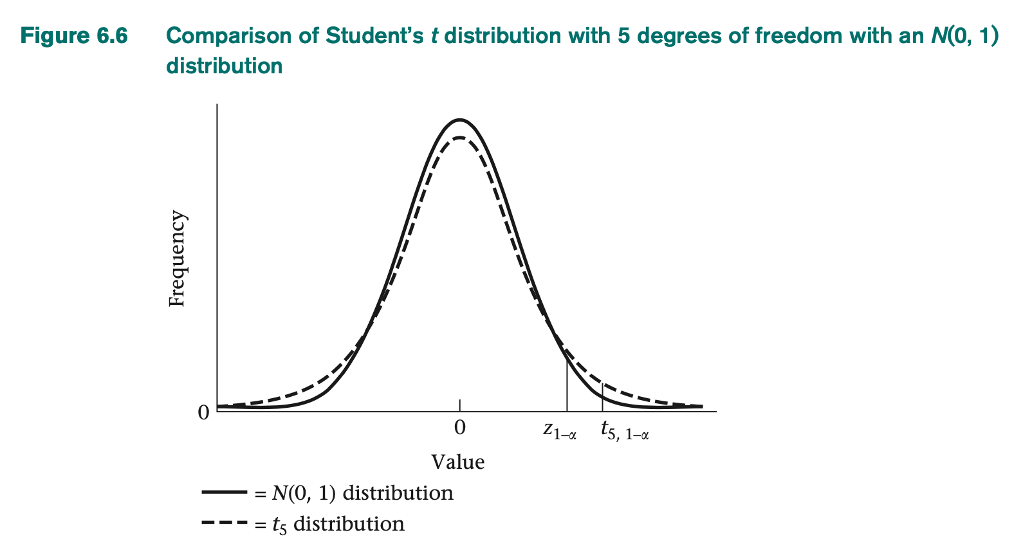
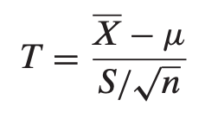

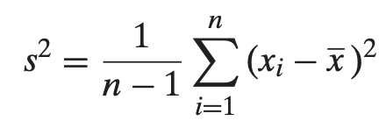

One-sided vs two-sided tests
Ex:
One-sample t Test for the mean of a normal distribution with unknown variance
H₀: $μ=μ$₀
Under the null,
~ t_{n-1}

Slide 25
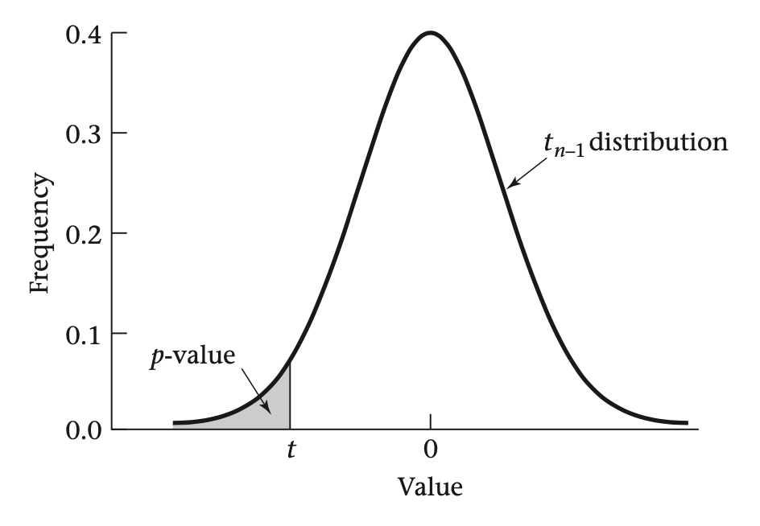



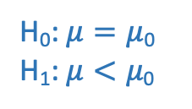
One-sided vs two-sided tests
One-sided alternative
H₀: $μ=μ$₀
H₁: $μ<μ\text{0}$
Rejection region at level 𝛼:
Calculation of p-value:

Slide 26
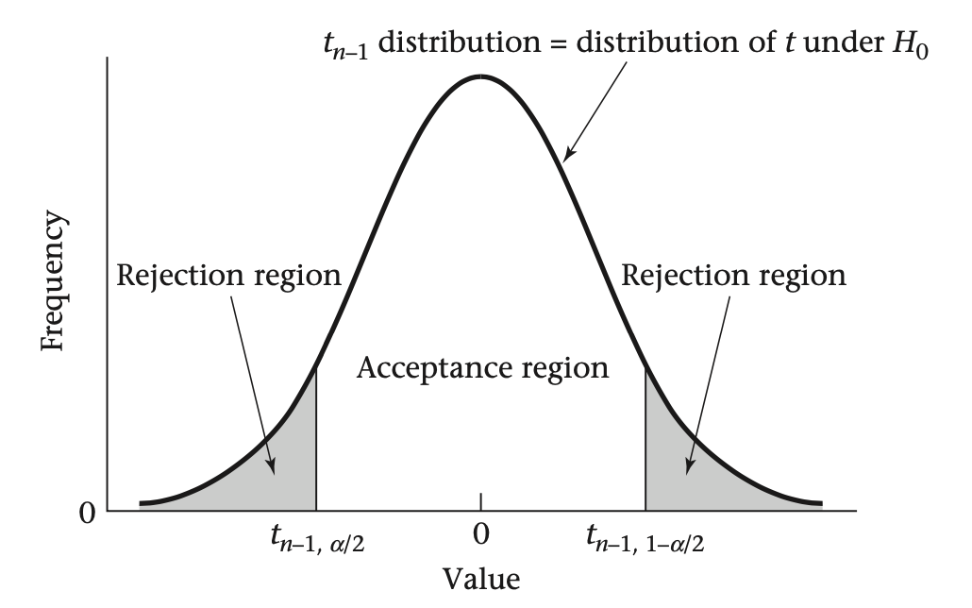
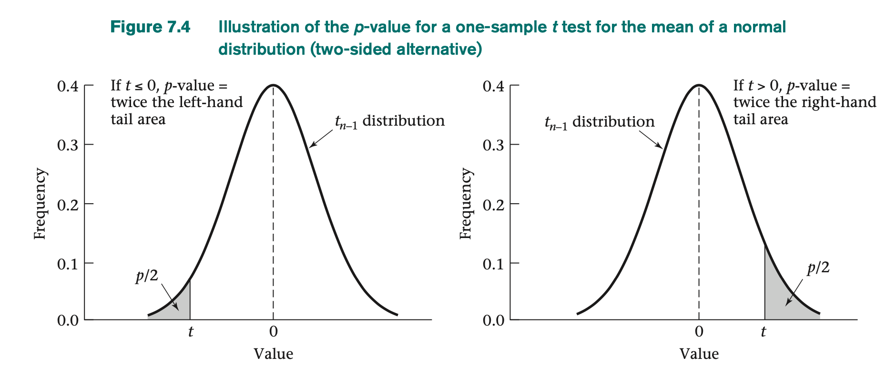
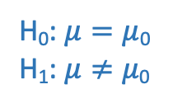
One-sided vs two-sided tests
Two-sided alternative
Rejection region at level 𝛼:
H₀: $μ=μ$₀
H₁: $μ≠μ\text{0}$
Calculation of p-value:

Slide 27
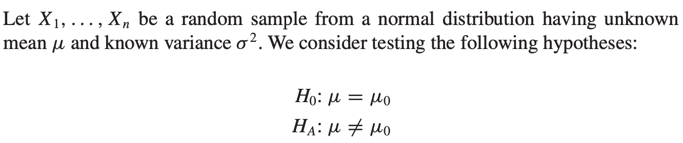



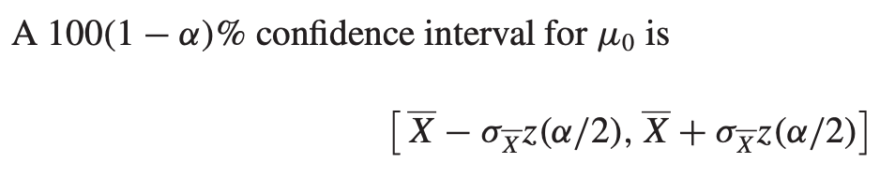
The Duality of Confidence Intervals and Hypothesis Tests
The acceptance region:
μ₀ lies in the confidence interval for μ if and only if the hypothesis test accepts.
The confidence interval consists precisely of all those values of μ₀ for which the null hypothesis H₀: μ = μ₀ is accepted.

Slide 28

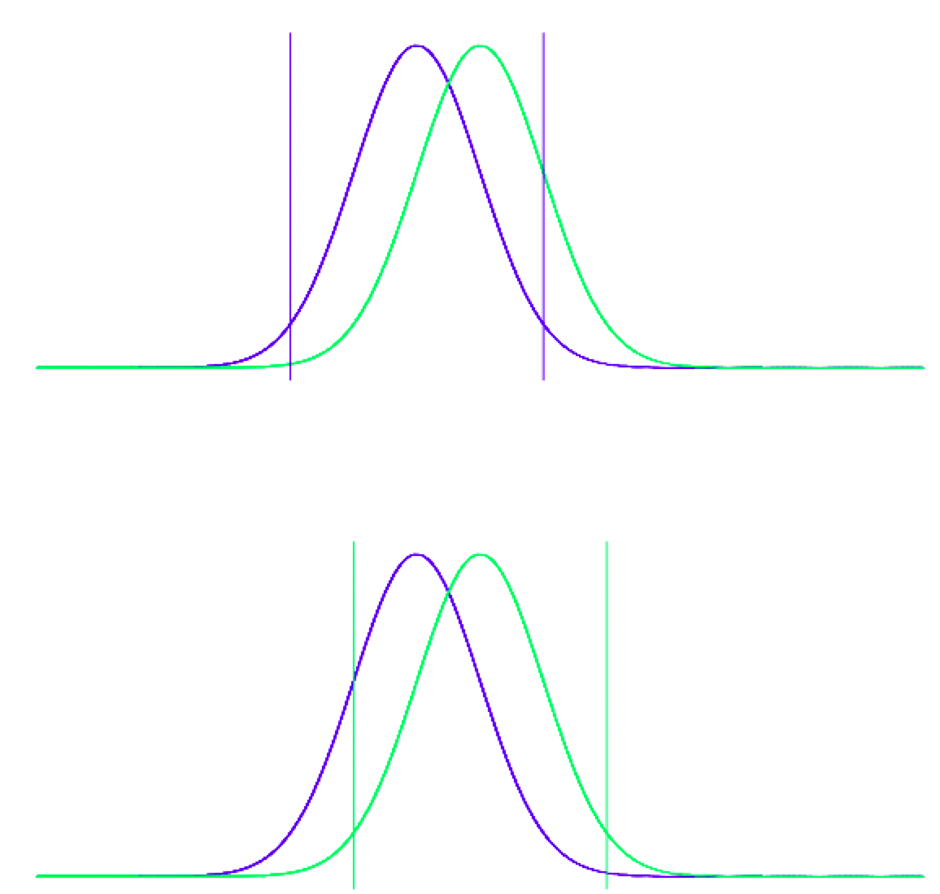
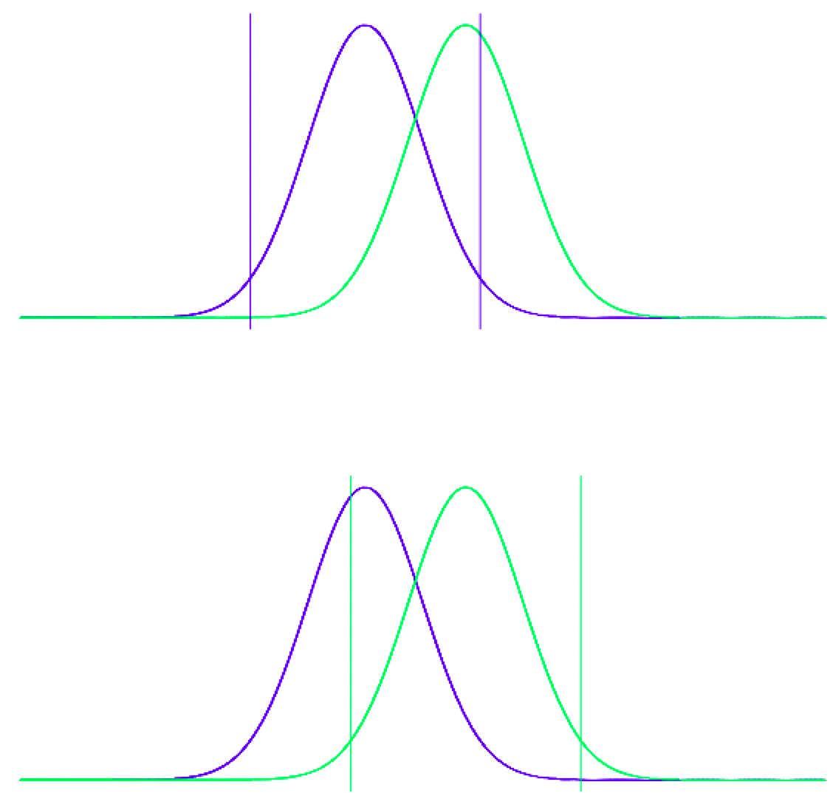
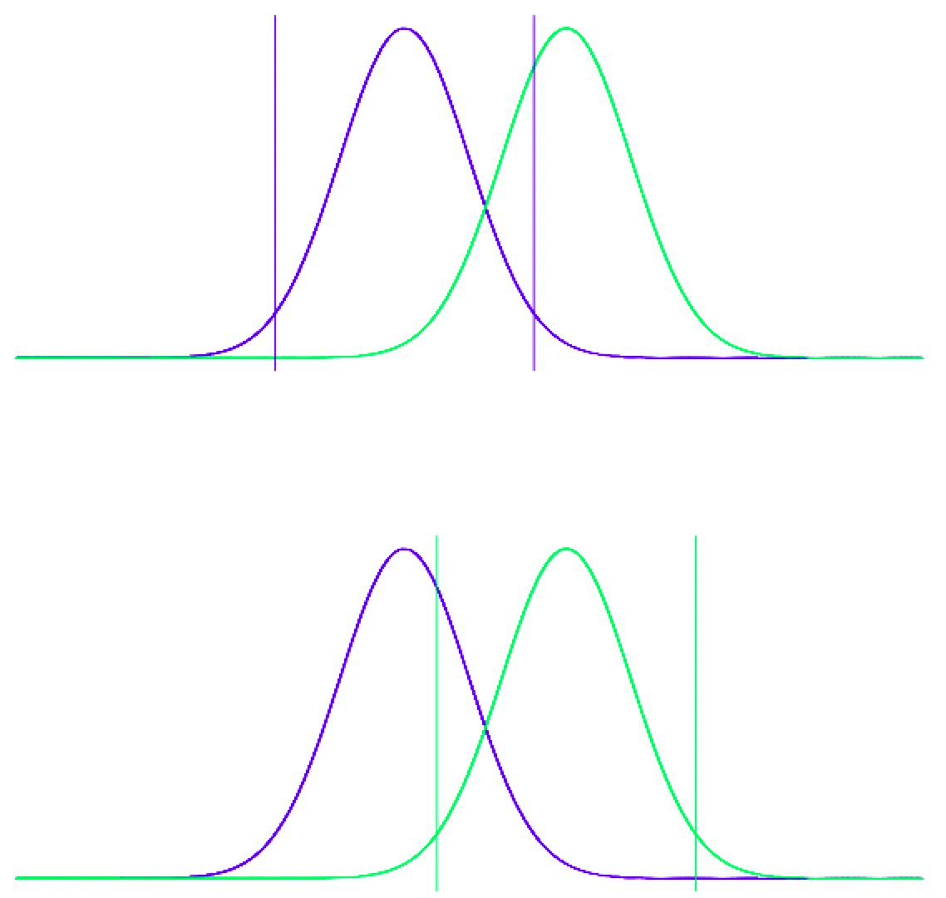
The Duality of Confidence Intervals and Hypothesis Tests
A symmetric relationship
μ₀
μ₀
μ₀
Acceptance
region
μ₀
μ₀
μ₀
CI
It all boils down to the distance between μ₀ and

